Slide 1
Shading I
Ed Angel
Professor of Computer Science, Electrical and Computer Engineering, and Media Arts
University of New Mexico
Angel: Interactive Computer Graphics 5E © Addison-Wesley 2009

Slide 2
Objectives
Learn to shade objects so their images appear three-dimensional
Introduce the types of light-material interactions
Build a simple reflection model---the Phong model--- that can be used with real time graphics hardware
Angel: Interactive Computer Graphics 5E © Addison-Wesley 2009

Slide 3
Why we need shading
Suppose we build a model of a sphere using many polygons and color it with glColor. We get something like
But we want
Angel: Interactive Computer Graphics 5E © Addison-Wesley 2009

Slide 4
Shading
Why does the image of a real sphere look like
Light-material interactions cause each point to have a different color or shade
Need to consider
  Light sources
  Material properties
  Location of viewer
  Surface orientation
Angel: Interactive Computer Graphics 5E © Addison-Wesley 2009

Slide 5
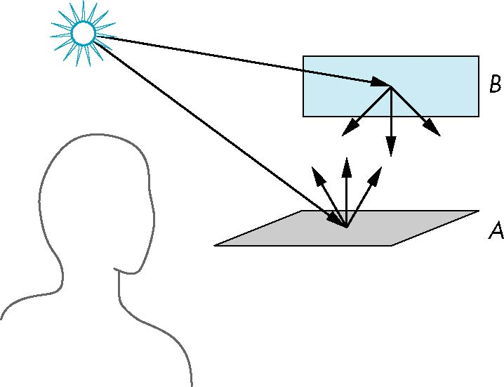
Scattering
Light strikes A
  Some scattered
  Some absorbed
Some of scattered light strikes B
  Some scattered
  Some absorbed
Some of this scattered
light strikes A
and so on
Angel: Interactive Computer Graphics 5E © Addison-Wesley 2009

Slide 6
Rendering Equation
The infinite scattering and absorption of light can be described by the rendering equation
  Cannot be solved in general
  Ray tracing is a special case for perfectly reflecting surfaces
Rendering equation is global and includes
  Shadows
  Multiple scattering from object to object
Angel: Interactive Computer Graphics 5E © Addison-Wesley 2009

Slide 7
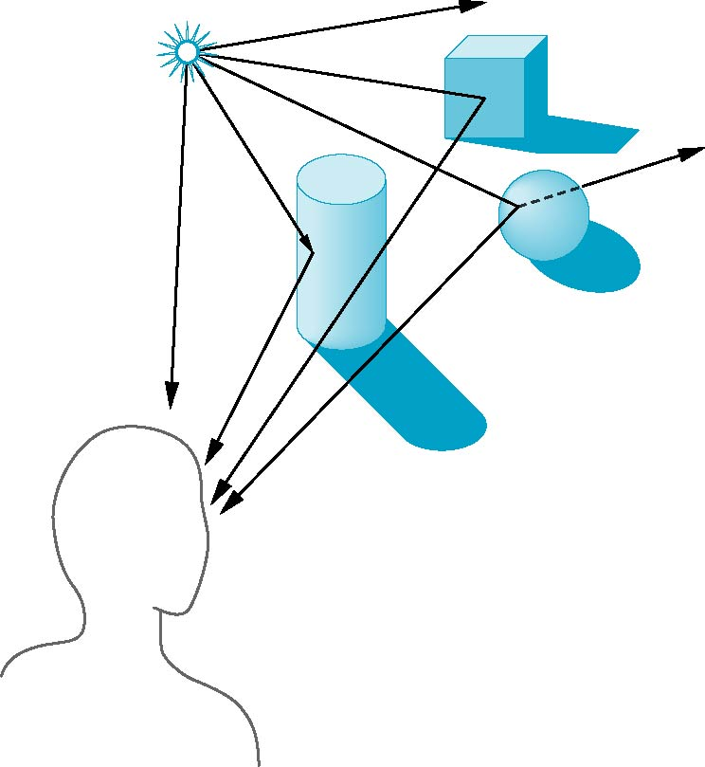
Global Effects
shadow
multiple reflection
translucent surface
Angel: Interactive Computer Graphics 5E © Addison-Wesley 2009

Slide 8
Local vs Global Rendering
Correct shading requires a global calculation involving all objects and light sources
  Incompatible with pipeline model which shades each polygon independently (local rendering)
However, in computer graphics, especially real time graphics, we are happy if things “look right”
  Exist many techniques for approximating global effects
Angel: Interactive Computer Graphics 5E © Addison-Wesley 2009

Slide 9
Light-Material Interaction
Light that strikes an object is partially absorbed and partially scattered (reflected)
The amount reflected determines the color and brightness of the object
  A surface appears red under white light because the red component of the light is reflected and the rest is absorbed
The reflected light is scattered in a manner that depends on the smoothness and orientation of the surface
Angel: Interactive Computer Graphics 5E © Addison-Wesley 2009

Slide 10
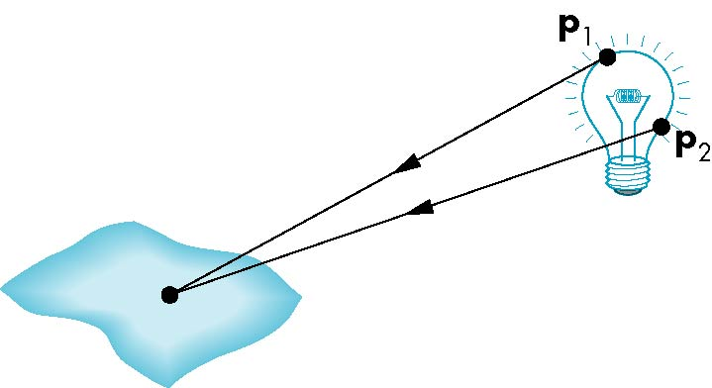
Light Sources
General light sources are difficult to work with because we must integrate light coming from all points on the source
Angel: Interactive Computer Graphics 5E © Addison-Wesley 2009

Slide 11
Simple Light Sources
Point source
  Model with position and color
  Distant source = infinite distance away (parallel)
Spotlight
  Restrict light from ideal point source
Ambient light
  Same amount of light everywhere in scene
  Can model contribution of many sources and reflecting surfaces
Angel: Interactive Computer Graphics 5E © Addison-Wesley 2009

Slide 12

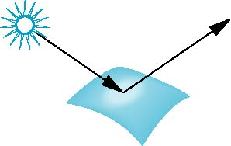
Surface Types
The smoother a surface, the more reflected light is concentrated in the direction a perfect mirror would reflected the light
A very rough surface scatters light in all directions
smooth surface
rough surface
Angel: Interactive Computer Graphics 5E © Addison-Wesley 2009

Slide 13
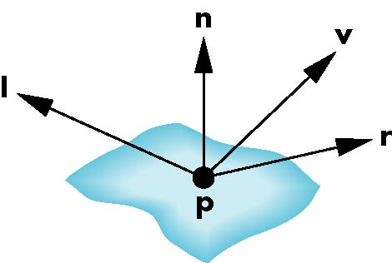
Phong Model
A simple model that can be computed rapidly
Has three components
  Diffuse
  Specular
  Ambient
Uses four vectors
  To source
  To viewer
  Normal
  Perfect reflector
Angel: Interactive Computer Graphics 5E © Addison-Wesley 2009

Slide 14
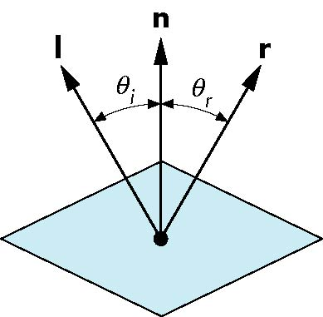
Ideal Reflector
Normal is determined by local orientation
Angle of incidence = angle of relection
The three vectors must be coplanar
r = 2 (l · n ) n - l
Angel: Interactive Computer Graphics 5E © Addison-Wesley 2009

Slide 15
Lambertian Surface
Perfectly diffuse reflector
Light scattered equally in all directions
Amount of light reflected is proportional to the vertical component of incoming light
  reflected light ~cos θ_{i}
  cos θ_{i} = l · n if vectors normalized
  There are also three coefficients, k_{r}, k_{b}, k_{g} that show how much of each color component is reflected
Angel: Interactive Computer Graphics 5E © Addison-Wesley 2009

Slide 16

Specular Surfaces
Most surfaces are neither ideal diffusers nor perfectly specular (ideal reflectors)
Smooth surfaces show specular highlights due to incoming light being reflected in directions concentrated close to the direction of a perfect reflection
specular
highlight
Angel: Interactive Computer Graphics 5E © Addison-Wesley 2009

Slide 17
Modeling Specular Relections
Phong proposed using a term that dropped off as the angle between the viewer and the ideal reflection increased
I_{r} ~ k_{s} I cos^{α}φ
φ
reflected
intensity
shininess coef
incoming intensity
absorption coef
Angel: Interactive Computer Graphics 5E © Addison-Wesley 2009

Slide 18
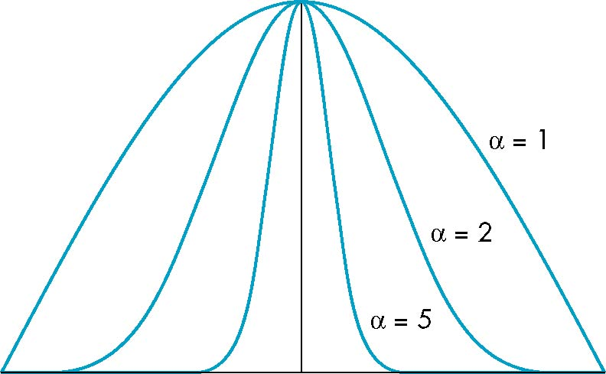
The Shininess Coefficient
Values of α between 100 and 200 correspond to metals
Values between 5 and 10 give surface that look like plastic
cos^{α} φ
-90
φ
90
Angel: Interactive Computer Graphics 5E © Addison-Wesley 2009

